Slide 1
The Influence of Confucianism
Past and Present Day
By: Jessica Berry

Slide 2
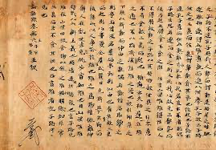
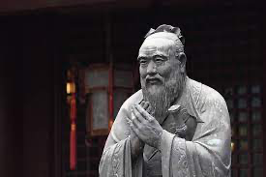
Who was Confucius?
Chinese Philosopher
Lived from 551 to 479 BC
From Qūfù (曲阜) which is now Shandong Province in China (中国)
Grew up in poverty, but still pursued education
Became a teacher (老师), philosopher, and political figure
Preached about ethics, morals, virtue, social harmony, familial relationships, and more
Did not write any books on his teachings, instead his disciples wrote The Analects after his death.
孔子
(Kǒngzǐ)

Slide 3
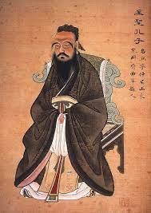
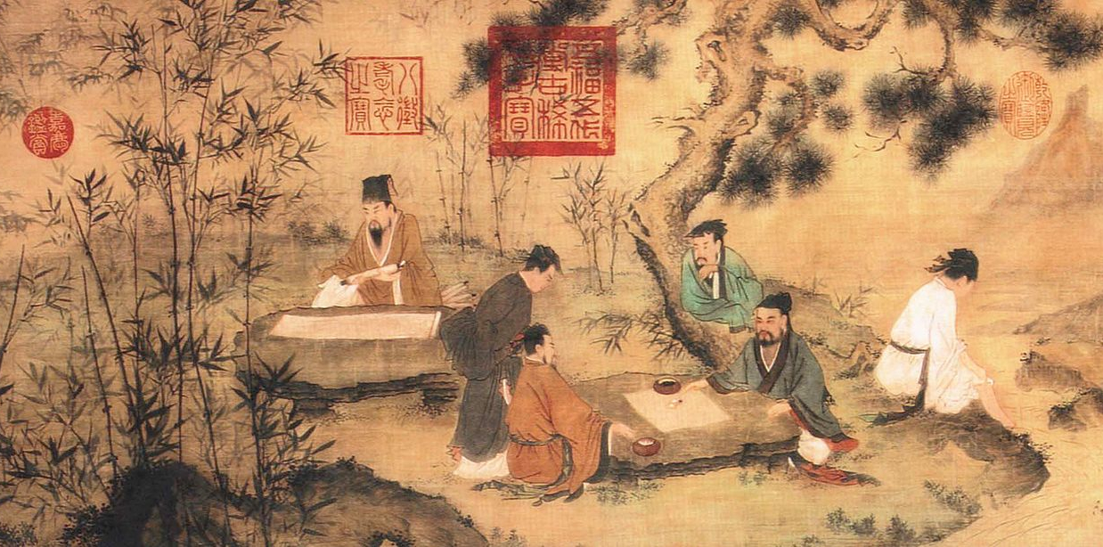
What is Confucianism?
Complex philosophical and ethical system
Social and political ethics based on central concepts
Emphasis on the importance of social harmony, moral cultivation, and proper conduct in individual and communal life.
The virtues were put in place to restore social order
Belief that the virtues were obtainable through education
Pushes for a meritocratic society
individuals appointed to positions of authority based moral virtue, wisdom, and ability not just birthright

Slide 4
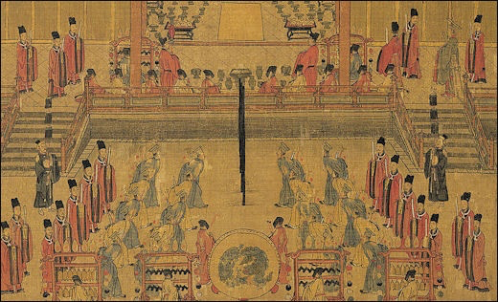
Central Confucian Concepts
Virtue (dé 德)
A moral, charismatic power that allows individuals to feel, think, and act a certain way to draw others to emulate their goodness.
The Way (dào 道)
The proper path for life/the ultimate foundation for everything
Effortless Action (wú-wéi 無為)
State of harmony where one’s life is integrated and one’s desires are in harmony with one’s actions

Slide 5
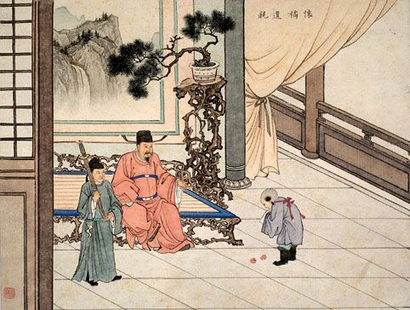
Central Confucian Concepts
Filial Piety (xiào 孝)
Directs one towards the good of one’s parents, your “root” of goodness
Benevolence (rén 仁)
Overall goodness → communal flourishing
Learning (xué 学)
Moral development through the internalization of classic practices and rituals

Slide 6
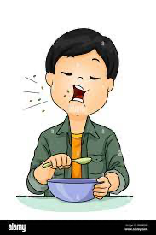
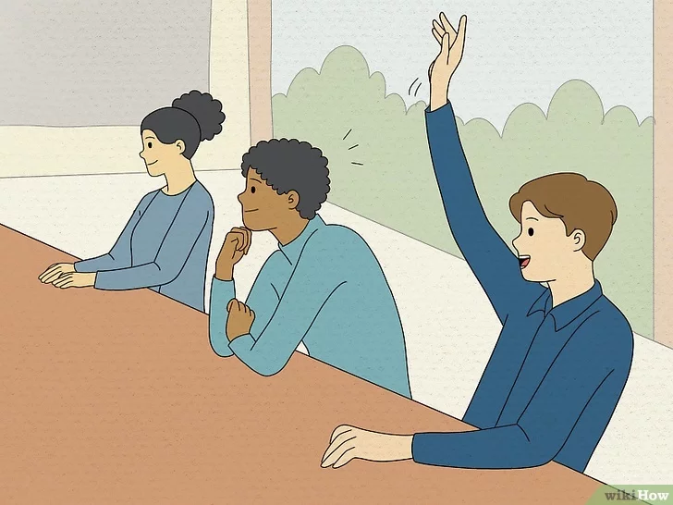
Ritual or Rite (Iǐ 禮)
Refers to ritual activities and the virtue of ritual propriety.
Includes social activities that bind communities together no matter the size.
A central goal of Confucius was the restoration of rituals.
He believed that ritualization permeates our human mode of being.
In order to make sense of ourselves and the world our feelings, behaviors, and thoughts must become ritualized.
They are teleologically ordered → directed towards some end or goal
Provides structure and cultural background that allows humans to move through the complex world. Rituals are used to create social norms, a shared understanding of what is appropriate or inappropriate behavior.

Slide 7
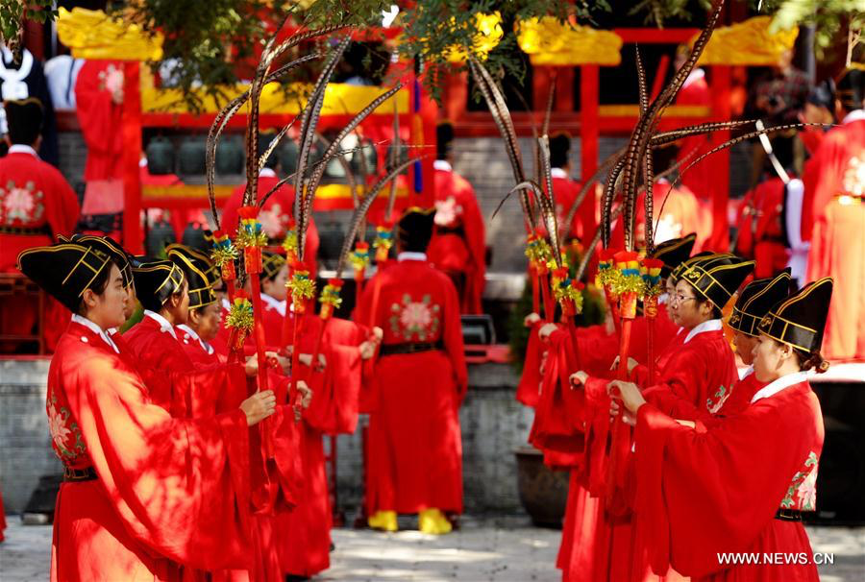
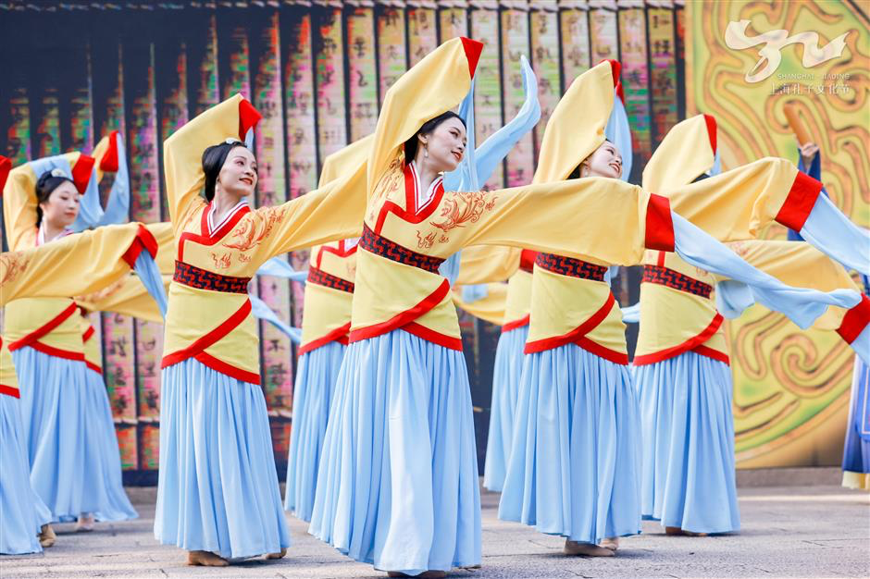
The Main Values of Rituals
Instrumental Value
A way to express respect for others
Provides a stable social environment
Allows for a harmonization of relationships
Engagement in joint activities
2. Intrinsic Value
Fundamental expressions of humanity
Ex. dances or musical performances
3. Narrative Value
Organization of our lives (structure and stability)
4. Religious Value
Understanding that there are some things we cannot comprehend
Way to express admiration for the sacred

Slide 8
Rituals and Roles
Certain roles require specific behaviors and rituals.
Roles often carry hierarchical structures.
Parent-child
Teacher-student
Ruler-people
Allows for a clearer moral structure → social harmony.
The role that you occupy should be fulfilled.
There you can achieve a sense of purpose or meaning.
By doing this you are actively contributing to your community.

Slide 9
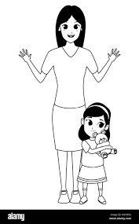
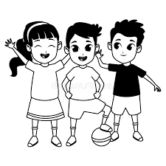
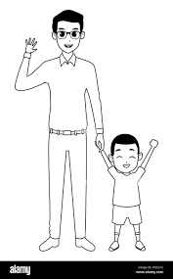
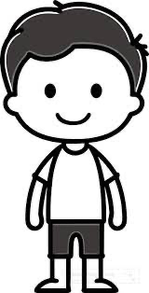
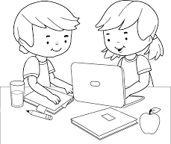
Examples of Roles
Teacher (老师)
Friend (朋友)
Mother (妈妈)
Student (学生)
Father (爸爸)
Child (孩子)

Slide 10
“Do not do unto others what you would not want others to do unto you.”
The Golden Rule of Confucianism

Slide 11
Modern Day Confucianism
Can be seen through the use of traditional roles. The most respect is given to the elders and authority. The hierarchical system is still in place in modern China today.
Modesty and humility, which stem from the Confusion idea of, rén, goodness, are seen today surrounding compliments. When people in China receive a compliment they will most likely respond, nali, nali, (哪里哪里) which translates to where?, where?
Confucian influence can also be seen in modern education. Confucius placed a heavy emphasis on scholarship, wanting to replace hereditary rule with one based on scholarship and learning. In modern day China there is still a heavy emphasis on education and scholarship.

Slide 12
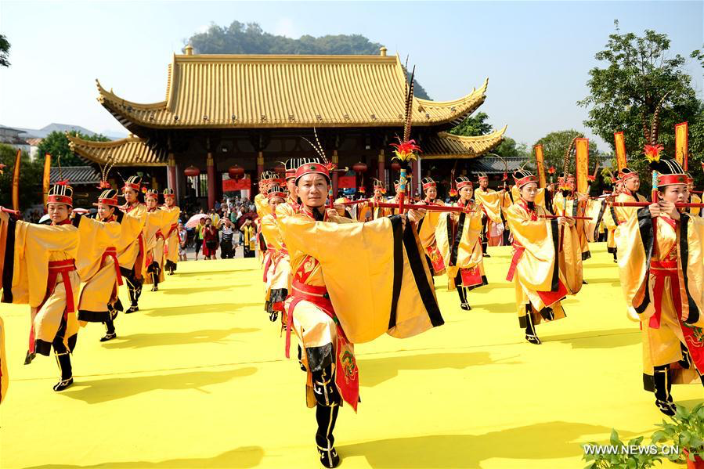
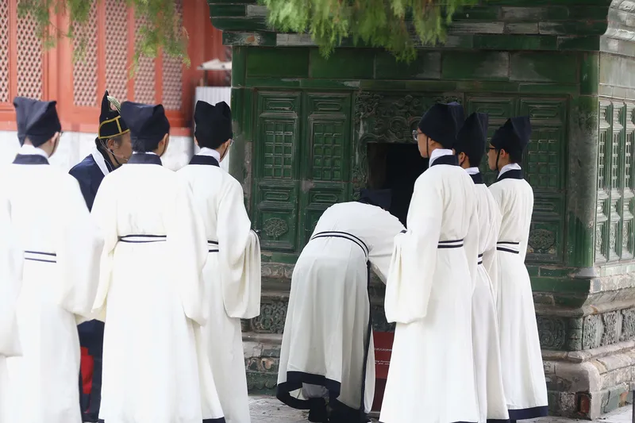
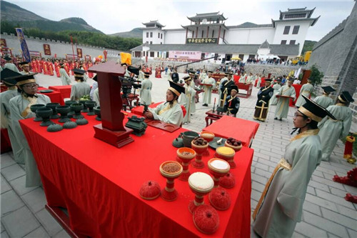
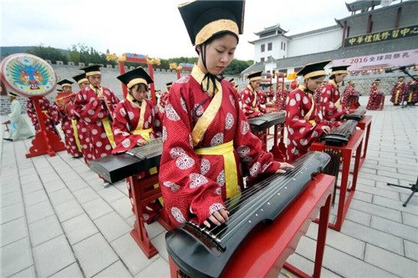
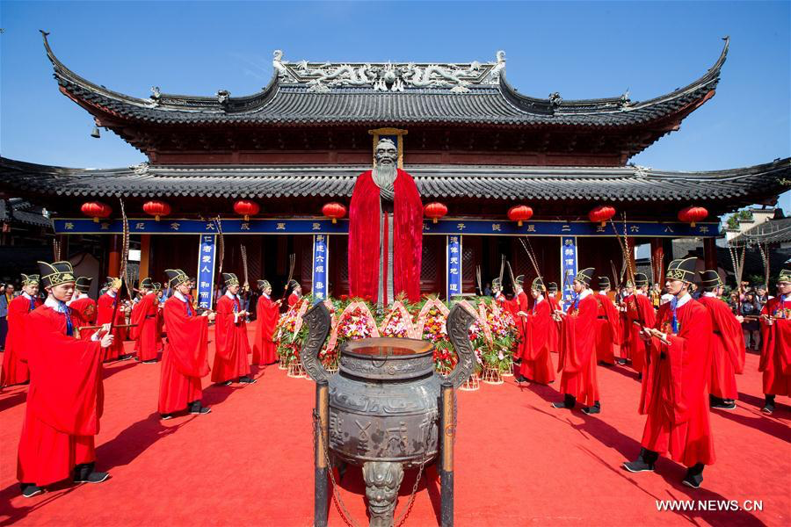
Fun Fact
There is a celebration on Confucius's birthday, September 28th, every year. Some aspects of these celebrations include dances, music, good food, and early rituals practiced within temples.

Slide 13
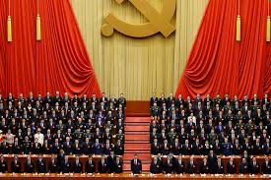
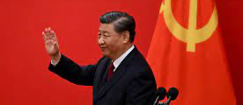
Modern Day Confucianism - Politics
Social Credit System:
Confucian values of social harmony and hierarchy are shown through the Social Credit System
The aim is to encourage positive behavior and discourage misconduct
System of rewards and penalties.
Emphasis on Moral Leadership:
Confucius placed emphasis on virtuous leadership and moral behavior among rulers
The Chinese Communist Party's took this over by promoting socialist core values and a leadership image that emphasizes moral authority and integrity.
Hierarchy and Order:
Chinese political system's structure and governance follow the same approach as Confucius
Centralized authority and significance on sustaining harmony and stability in society
Cultural Continuity:
Confucianism created a foundation of culture and history for current political policies and ideologies

Slide 14
Sources
China Daily. “Shandong Culture.” Celebrating Confucius’ Birthday in His Hometown - Shandong Culture, Shandong Provincial Department of Culture and Tourism , 29 Sept. 2016, www.chinadaily.com.cn/m/shandong/shandongculture/2016-09/29/content_26940400.htm.
China Mike. “Confucius 101: Key to Understanding the Chinese Mind.” China Mike, China-Mike, 21 May 2020, www.china-mike.com/chinese-culture/confucius/.
“Confucius’ Birthday.” China.Org.Cn, China.org.cn, www.china.org.cn/english/olympic/211894.htm. Accessed 18 Mar. 2024.
Elshaikh, Eman M. “Read: Confucianism (Article).” Khan Academy, Khan Academy, 2024, www.khanacademy.org/humanities/whp-origins/era-3-cities-societies-and-empires-6000-bce-to-700-c-e/35-development-of-belief-systems-betaa/a/read-confucianism-beta.
Hays, Jeffrey. “Confucianism, Family, Society, Filial Piety and Relationships.” Facts and Details, factsanddetails, Sept. 2021, factsanddetails.com/china/cat3/sub9/entry-5561.html.
Meiping, Yang. “Ritual Dances, Songs Launch Confucian Culture Festival.” SHINE, shine.cn, 21 Sept. 2021, www.shine.cn/news/metro/2109215367/.
National Geographic Society. “Confucianism.” Education, National Geographic, 6 Mar. 2024, education.nationalgeographic.org/resource/confucianism/.
Venkatesh, Krishnan. “‘Filial Piety’: The Heart of Confucian Life.” Voices From Antiquity, Word Press, 12 Apr. 2017, voicesfromantiquity.wordpress.com/2017/04/12/filial-piety-the-heart-of-confucian-life/.
Xiaoci, Deng. “Nationwide Confucius Events Are Reaction to Crisis of Values: Analysts.” People’s Daily Online, people.cn, 30 Sept. 2016, en.people.cn/n3/2016/0930/c90000-9122123.html.

